Slide 1
Part I
Project Initiation

Slide 2
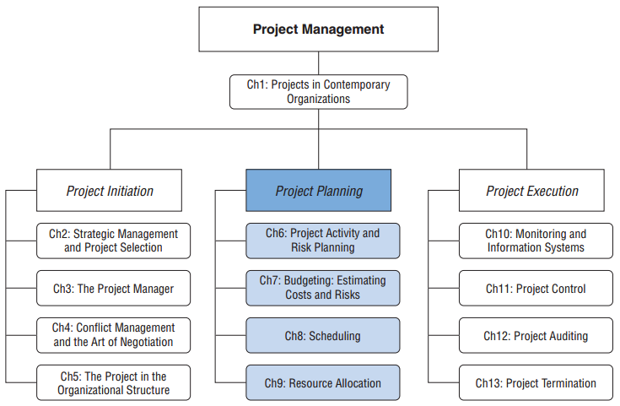
Project Management
2-<number>

Slide 3
Chapter 2
Strategic Management and Project Selection

Slide 4
Poor Project Results
Organizations spend $100 billion per year on creating competitive strategies
  90% fail due to poor project execution
Other poor results:
  < 50% strategically projects successful
  >25% lacked sponsor and detailed implementation process
  40% had adequately skilled personnel
  Only 20% prioritized hiring skilled staff

Slide 5
How To Improve
Projects, programs, and project portfolios
The best firms have:
  Top management involvement
  Get the most feedback
  Dedicate the most resources
  Have the most robust processes
Implementation is the critical skill in strategic and competitive success

Slide 6
Challenges in Project Management
Triple Constraint, but also:
  Meeting the strategic goals
  Linking the strategic elements with tactical elements
  Streamlining decision making
  Increase efficiencies
  Better align with organizational goals
  Coping with ambiguity and complexity
  Keeping up with technology
  Coordinating interdependent systems

Slide 7
Complex Strategic Project Problems
Agency Theory
Governance Theory
Both of these theories embedded in organizational project management (OPM)

Slide 8
OPM
Developed as a framework for executing strategies through projects
Combines the systems of portfolio, program, and project management
Incorporated into PMI’s OPM Maturity Model

Slide 9
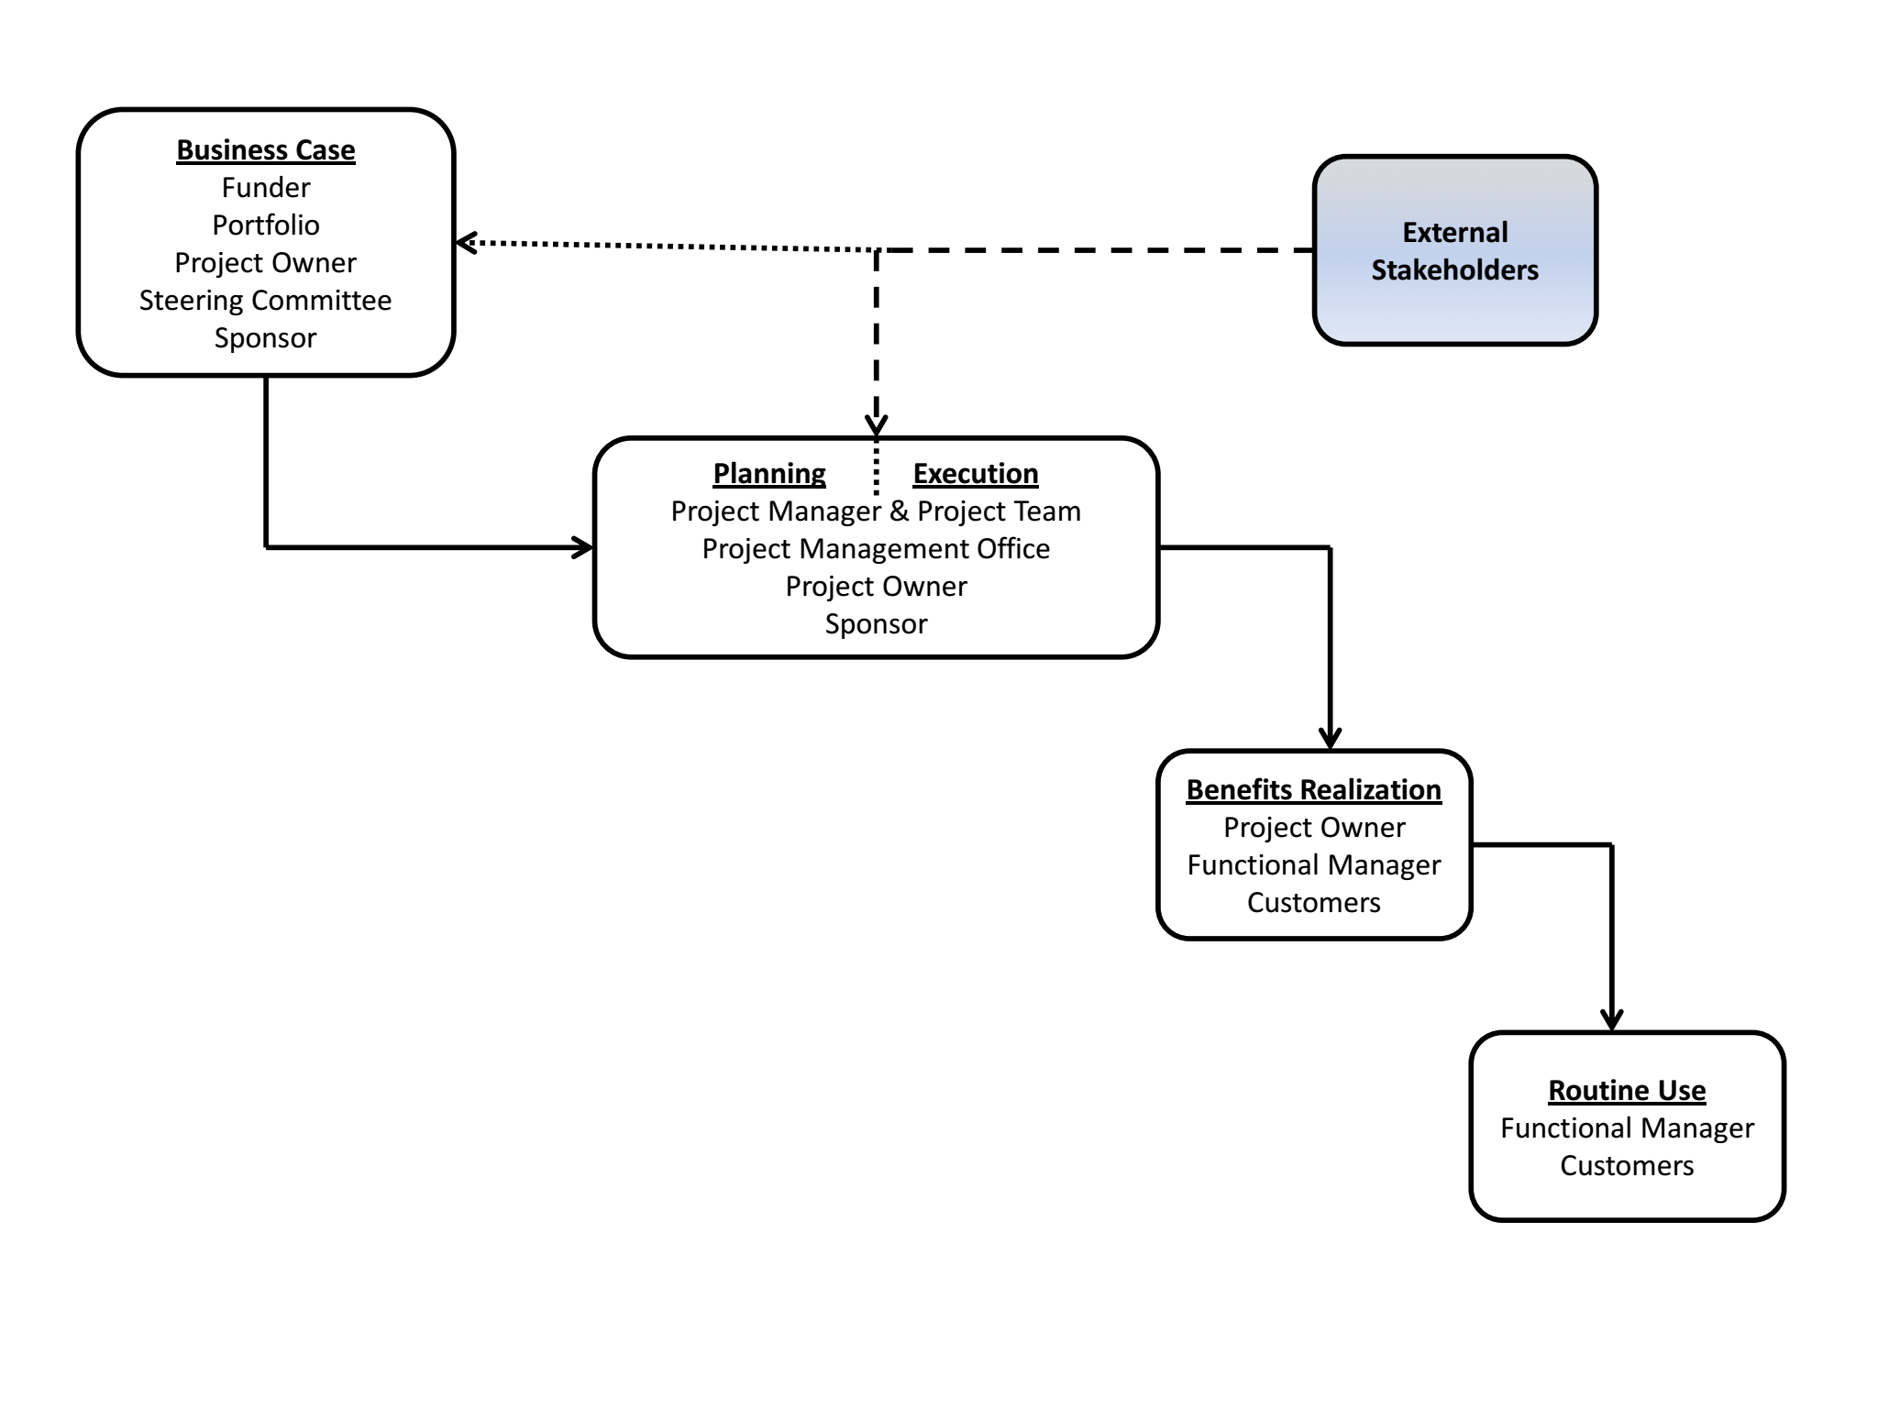
Governance Structure For Strategic Projects

Slide 10
Business Case
Presented to a funding entity
Includes
  Monetary cost
  Benefits
  Nonmonetary factors
    Strategic justification
    Expected behavioral impacts
    Increases in efficiency
    Service improvements
    Etc.
Copyright ©2018 John Wiley & Son, Inc.

Slide 11
Project Selection Models
Project selection…
  Evaluating
  Choosing
  Implementing
Same process as other business decisions
Project selection is critical to long-term org survival
2-<number>

Slide 12
Types of Project Selection Models
Nonnumeric models
Numeric models
These can be used simultaneously
2-<number>

Slide 13
Nonnumeric Models
Models that do not return a numeric value for a project to be compared with other projects
These are really not “models” but rather justifications for projects
Just because they are not true models does not make them all “bad”
2-<number>

Slide 14
Types of Nonnumeric Models (Slide 1 of 2)
Sacred Cow
  Often suggested by top management
  Maintained until completion or boss terminates it
Operating Necessity
  A project that is required in order to protect lives or property or to keep the company in operation
Competitive Necessity
  A project that is required in order to maintain the company’s position in the marketplace
2-<number>

Slide 15
Types of Nonnumeric Models (Slide 2 of 2)
Product Line Extension
  Project evaluated on fit with existing product line, fills a gap, strengthens a weak link, or extends a line
Comparative Benefit
  Projects are subjectively rank ordered based on their perceived benefit to the company
Sustainability
  Focusing on long-term profitability rather than short-run payoff
2-<number>

Slide 16
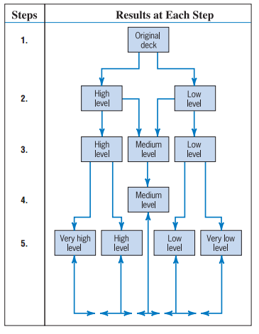
Q-Sort Method
2-<number>

Slide 17
Numeric Models
Models that return a numeric value for a project that can be easily compared with other projects
Major types
  Profit/profitability
  Real Options
  Scoring
  Window-of-opportunity analysis
  Discovery-driven planning
2-<number>

Slide 18
Numeric Models: Profit/Profitability
Models that look at costs and revenues
  Payback period
  Discounted cash flow (NPV)
2-<number>

Slide 19
Payback Period
The length of time until the original investment has been recouped by the project
A shorter payback period is better
2-<number>

Slide 20
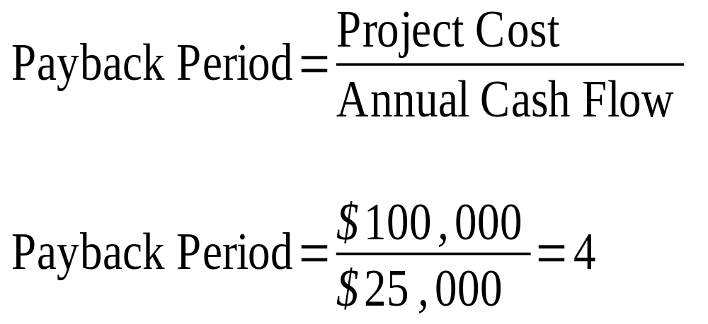
Payback Period Example
2-<number>

Slide 21
Payback Period Drawbacks
Does not consider time value of money
More difficult to use when cash flows change over time
Less meaningful for longer periods of time (due to time value of money)
2-<number>

Slide 22
Discounted Cash Flow (Slide 1 of 2)
The value of a stream of cash inflows and outflows in today’s dollars
Also know as discounted cash flow or just discounting
Widely used to evaluate projects
Includes the time value of money
Includes all inflows and outflows, not just the ones through payback point
2-<number>

Slide 23
Discounted Cash Flow (Slide 2 of 2)
Requires a percentage to use to reduce future cash flows
  This is known as the discount rate
The discount rate may also be known as a hurdle rate or cutoff rate
There will usually be one overall discount rate for the company
2-<number>

Slide 24
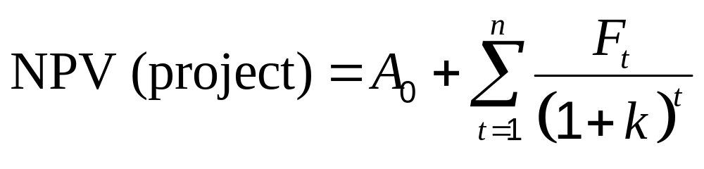
NPV Formula
(1 + k + p_{t})^{t}
2-<number>

Slide 25
NPV Formula Terms
A₀ Initial cash investment
F_{t} Cash flow in time period t (negative for
outflows)
k The discount rate
p_{t} Predicted rate of inflation during period t
t The number of years of life
A higher NPV is better
Higher the discount rate lower the NPV
2-<number>

Slide 26
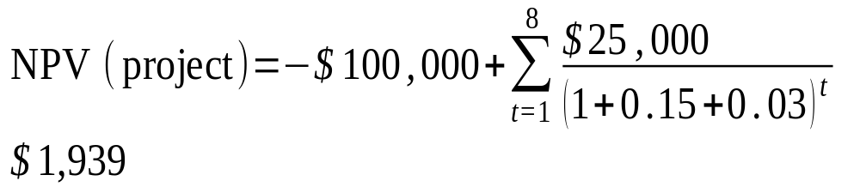
NPV Example
2-<number>

Slide 27
Numeric Models: Real Options
Positions the organization to capitalize on future opportunities
Utilized to reduce both technological and commercial risk
2-<number>

Slide 28
Numeric Models: Scoring
Mimics how managers actually evaluate investments
Uses multiple criteria
  Can utilize both monetary and qualitative factors
Weighted factor scoring model
2-<number>

Slide 29
Weighted Factor Scoring Model
Each factor is weighted relative to its importance
  Weighting allows important factors to stand out
A good way to include nonnumeric data in the analysis
Factors need to sum to one
All weights must be set up, so higher values mean more desirable
Small differences in totals are not meaningful
2-<number>

Slide 30
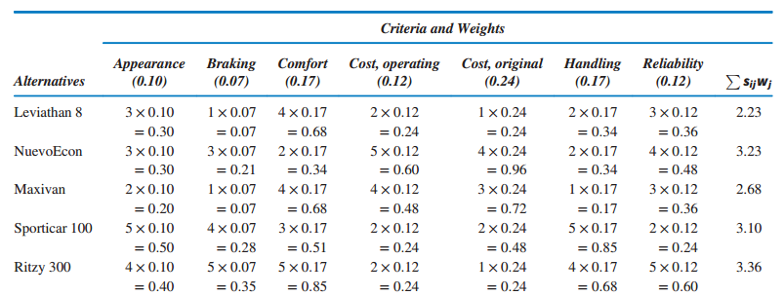
Weighted Factor Model Example
2-<number>

Slide 31
Advantages of Scoring Models
Allow multiple criteria
Structurally simple
Intuitive and reflect actual thinking process
Direct reflection of managerial policy
Easily altered
Allow for more important factors
Allow easy sensitivity analysis
2-<number>

Slide 32
Disadvantages of Scoring Models
Relative measure
Linear in form
Can have large number of criteria
Unweighted models assume equal importance
2-<number>

Slide 33
Numeric Models:
Window-of-Opportunity Analysis
A process where the cost, time, and performance specs are defined that must be met before any R&D work
2-<number>

Slide 34
Numeric Models:
Discovery-Driven Planning
Similar to W-o-O
Funds enough of the project to determine if the initial assumptions were accurate
Used to learn more about the project, rather than necessarily implement it
2-<number>

Slide 35
Choosing a Project Selection Model
Weighted scoring models favored:
  Allow multiple objectives to be considered
  Easily adapted
  Not biased toward short-run like the profitability models
2-<number>

Slide 36
Risk Considerations in Project Selection
Both costs and benefits are uncertain
  Benefits are more uncertain
There are many ways of dealing with risk
Can make estimates about the probability of outcomes
  Subjective probabilities
Uncertainty about:
  Timing
  What will be accomplished?
  Side effects
Pro forma documents
2-<number>

Slide 37
Project Portfolio Management (PPM)
Organizations should maintain portfolios of projects
Links projects directly to the goals and strategy of the organization
Means for monitoring and controlling projects
2-<number>

Slide 38
Symptoms of a Misaligned Portfolio
More projects
Inconsistent determination of benefits
Projects that don’t contribute to the strategy
Competing projects
Costs exceed benefits
No risk analysis of projects
Lack of tracking against the plan
No client for project
2-<number>

Slide 39
Purpose of Project Portfolio Process (Slide 1 of 2)
Identify nonprojects
Prioritize list of projects
Limit number of projects
Identify the real options for each project
Identify projects with good fit
Identify co-dependent projects
2-<number>

Slide 40
Purpose of Project Portfolio Process (Slide 2 of 2)
Eliminate risky projects
Eliminate projects that skip the formal selection process
Keep from overloading the organization
To balance the resources with needs
To balance returns
To balance short-, medium-, and long-term returns
2-<number>

Slide 41
Project Portfolio Process Steps
Establish a project council
Identify project categories and criteria
Collect project data
Assess resource availability
Reduce the project and criteria set
Prioritize the projects within categories
Select the projects to be funded and held in reserve
Implement the process
2-<number>

Slide 42
Step 1: Establish a Project Council
Senior management
The project managers of major projects
The head of the Project Management Office
Particularly relevant general managers
Those who can identify key opportunities and risks facing the organization
Anyone who can derail the PPP later on
2-<number>

Slide 43
Step 2: Identify Project Categories and Criteria
Derivate projects
Platform projects
Breakthrough projects
R&D projects
2-<number>

Slide 44
Step 3: Collect Project Data
Assemble the data
Document assumptions
Screen out weaker projects
The fewer projects that need to be compared and analyzed, the easier the work of the council
2-<number>

Slide 45
Step 4: Assess Resource Availability
Assess both internal and external resources
Assess labor conservatively
Timing is particularly important
2-<number>

Slide 46
Step 5: Reduce the Project and Criteria Set
Organization’s goals
Have competence
Market for offering
How risky the project is
Potential partner
Right resources
Good fit
Use strengths
Synergistic
Dominated by another
Has slipped in desirability
2-<number>

Slide 47
Step 6: Prioritize the Projects Within Categories
Apply the scores and criterion weights
Consider in terms of benefits first and resource costs second
Summarize the returns from the projects
2-<number>

Slide 48
Step 7: Select the Projects to be Funded and Held in Reserve
Determine the mix of projects across the categories
Leave some resources free for new opportunities
Allocate the categorized projects in rank order
2-<number>

Slide 49
Step 8: Implement the Process
Communicate results
Repeat regularly
Improve process
2-<number>

Slide 50
Copyright
Copyright © 2018 John Wiley & Sons, Inc.
All rights reserved. Reproduction or translation of this work beyond that permitted in Section 117 of the 1976 United States Act without the express written permission of the copyright owner is unlawful. Request for further information should be addressed to the Permissions Department, John Wiley & Sons, Inc. The purchaser may make back-up copies for his/her own use only and not for distribution or resale. The Publisher assumes no responsibility for errors, omissions, or damages, caused by the use of these programs or from the use of the information contained herein.
Copyright ©2018 John Wiley & Son, Inc.

